Slide 1
DRY TRANSFER OF 2D MATERIALS
Name : Karthikeya Hanu Prakash Kanithi
Roll No : EE22BTECH11026

Slide 2
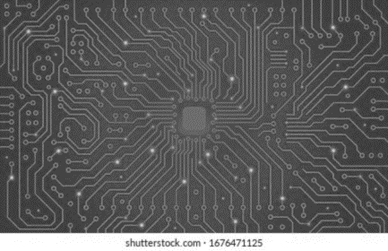
Index
2D Materials
Steps for Exfoliation
Steps for Visco - Elastic Transfer / Stamping
Thin Film deposition and its types
Ferroelectric materials
FTC [Ferroelectric Tunnel Junction] and quantum tunnelling
Steps for read and write operation.

Slide 3
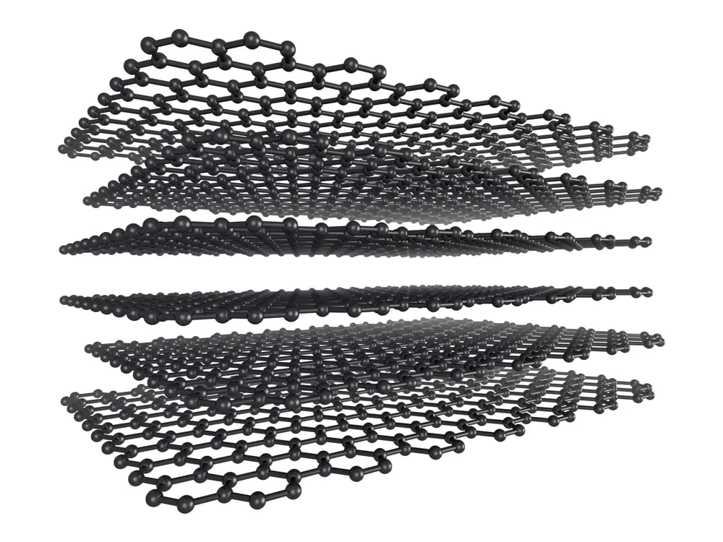
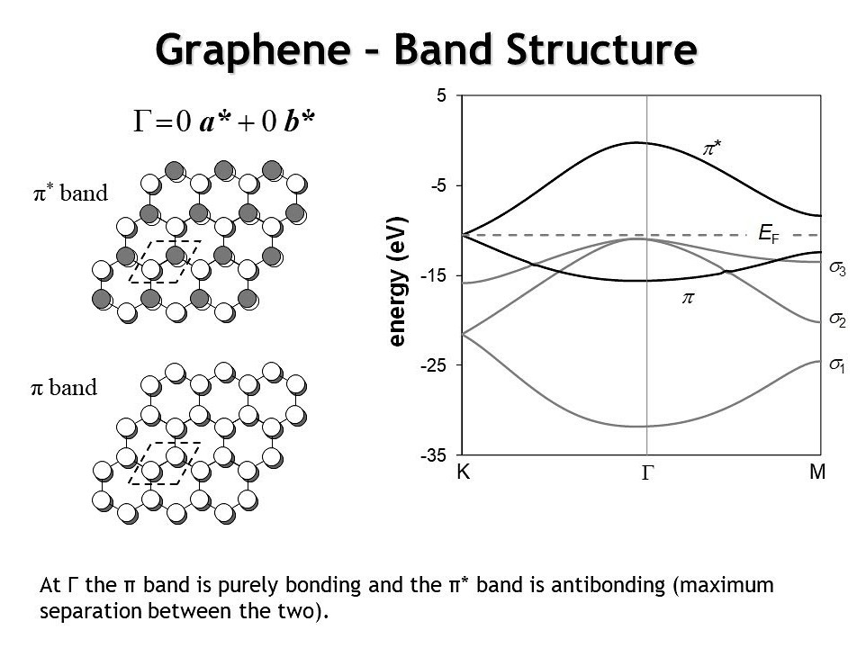
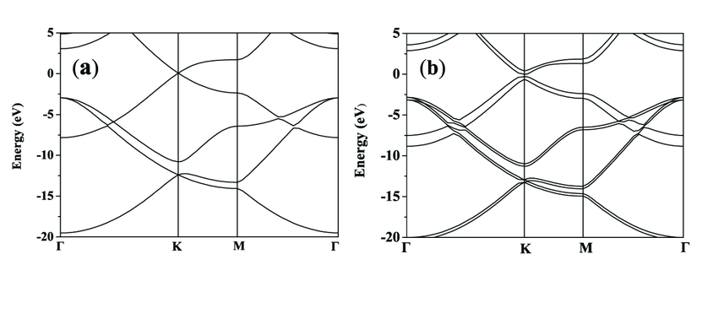
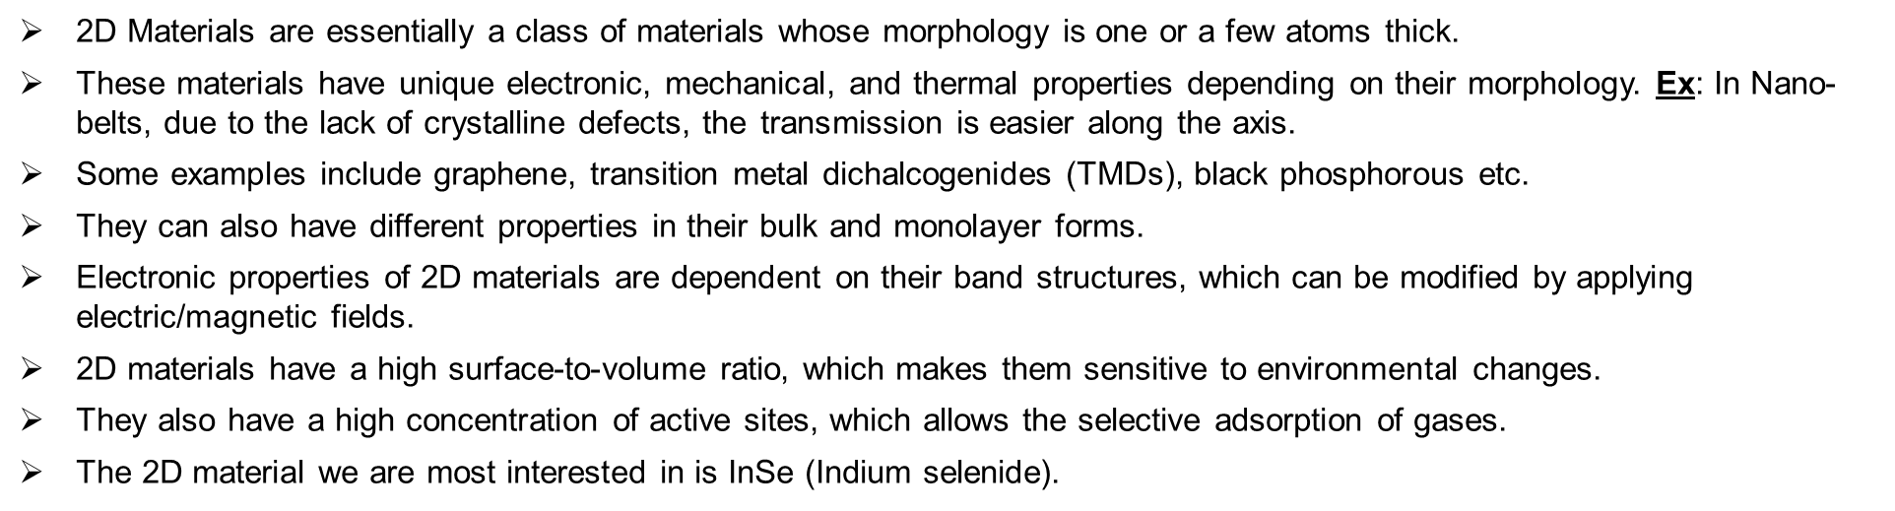
2D Materials
2D Materials are essentially a class of materials whose morphology is one or a few atoms thick.
These materials have unique electronic, mechanical, and thermal properties depending on their morphology. Ex: In Nano-belts, due to the lack of crystalline defects, the transmission is easier along the axis.
Some examples include graphene, transition metal dichalcogenides (TMDs), black phosphorous etc.
They can also have different properties in their bulk and monolayer forms.
Electronic properties of 2D materials are dependent on their band structures, which can be modified by applying electric/magnetic fields.
2D materials have a high surface-to-volume ratio, which makes them sensitive to environmental changes.
They also have a high concentration of active sites, which allows the selective adsorption of gases.
The 2D material we are most interested in is InSe (Indium selenide).

Slide 4
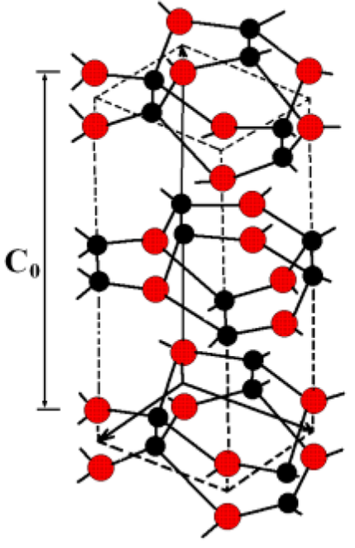
InSe (Indium Selenide)
InSe is a 2D material from the family of transition metal dichalcogenides (TMDs).
InSe consists of stacked layers of indium and selenium atoms.
Each layer is held together by relatively weak Van der Waals forces, allowing for easy exfoliation into individual atomic layers.
Some Key characteristics of InSe are given below
Thickness and Structure: InSe is typically obtained as single or few atomic layers. The individual layers are hexagonally arranged and stacked on top of each other. A single layer of InSe is 0.7 nm in thickness.
Band Gap: InSe has an indirect band gap in the bulk form. However, when thinned to the monolayer level, it transitions to a direct band gap semiconductor. Typically, the value lies between 1.2 eV to 1.4 eV.
Optical Properties: InSe exhibits strong optical absorption in the visible and near-infrared regions of the electromagnetic spectrum, making it suitable for optoelectronic applications such as photodetectors, photovoltaics, and light-emitting devices.
Note: It also exhibits ferromagnetic properties, which is very crucial and shall be discussed later on

Slide 5
Exfoliation
Exfoliation is the precise technique of extracting monolayers from bulk materials/crystals, achieved through mechanical, chemical, or electrochemical processes.
It enables the creation of atomically thin structures with tailored properties, vital for advanced nanoelectronic device fabrication.
Some methods of Exfoliation are given below
Mechanical Exfoliation: An example of this method is using scotch tape to isolate graphene layers from graphite. Here, we apply scotch tape to the bulk graphene and peel it off repeatedly. The adhesive forces of the scotch tape overpower the Vander Waal forces between the layers of the bulk graphite, gradually thinning it down to single or few-layer graphene flakes.
Chemical Exfoliation: We generally use this method if strong forces rather than weak forces bind the mono-layers. An example is the use of strong acids to selectively etch away the layers of the bulk material, leaving behind exfoliated layers with desired properties. One instance is the exfoliation of MoS2 using lithiated intercalants followed by sonication.
Electronic Exfoliation: Similarly, this method is generally used if strong forces rather than weak forces bind the mono-layers. In this method, an electric potential is applied to induce the intercalation of ions into the bulk material, leading to the expansion and subsequent exfoliation of layers.

Slide 6
Steps for exfoliation of InSe (Understanding)
Securely place the bulk crystal material onto one side of a Scotch or Nitto tape, ensuring proper alignment.
Then encapsulate the crystal with the other side of the tape. Apply gentle pressure to ensure proper contact between the tape adhesives and the surface of the bulk crystals.
Pull apart both ends of the tape. Now slightly adjust the position of the tape such that the bulk crystal overlaps with the clean part of the tape.
Now, once again, encapsulate the bulk material with the tape and pull them apart. Repeat the above processes until the desired thickness of the new layered crystalline structure.
After we obtain our desired thickness, we deposit the obtained crystal layer onto our stamp, (which in this case PDMS) to further transfer the 2D materials onto the patterned substrate.

Slide 7
Visco-Elastic Transfer
Visco-Elastic materials: Viscoelastic materials display properties of both fluids and solids, adapting their behavior based on applied stress or strain. They can be used for stamp production as they facilitate the transfer of 2D materials due to their adaptability. Ex: Polydimethylsiloxane (PDMS), Polyurethane (PU), Polystyrene (PS).
Visco-Elastic Transfer:
To create the stamp, a liquid viscoelastic blend is poured onto a substrate and solidified using methods like spin-coating or printing.
After formation, the stamp is applied to the source substrate, where pressure conforms it to the material surface, allowing for the transfer of 2D materials upon peeling the stamp away.
Q) Why must we use an intermediate like PDMS for 2D material transfer? Can’t we directly use the Nitto/scotch tape to transfer the 2D materials to the patterned substrates?
Ans: Using PDMS for stamping offers several advantages over direct exfoliation from tapes onto patterned substrates:
Uniformity: Stamping can result in more uniform coverage of the 2D material on the substrate than direct exfoliation, which may lead to variations in thickness.
Large-Scale Transfer: Stamping can facilitate the transfer of large-area 2D materials onto patterned substrates more efficiently than manual exfoliation from tapes.
Reduced Contamination: Stamping with PDMS stamps can minimize contamination from the transfer tape, as the PDMS stamp acts as an intermediate layer between the tape and the substrate.

Slide 8
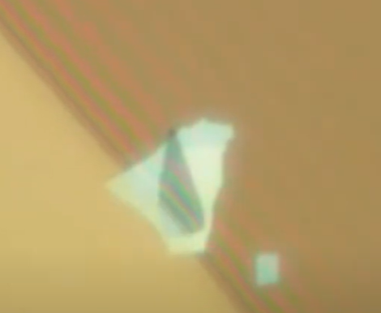
Steps for Visco Elastic transfer (Understanding)
Before deposition, glass slides need to be cleaned to remove any dust or organic residues that can interfere with stamp adhesion and lead to the formation of bubbles.
Prepare the PDMS stamp by cleaning it thoroughly to ensure proper adhesion and transfer and also clean the substrates using IPA solution to remove any dust particles/residues.
Place the stamp onto the layered crystal structure obtained from the tape exfoliation process.
Apply gentle pressure to allow the viscoelastic properties of the PDMS stamp to conform to the surface morphology of the crystal structure.
Slowly peel off the stamp, ensuring the crystal layers adhere to the stamp surface.
Then we take the cleaned glass slide and attach the substrate onto the glass slide, thereby fixing its position.
Then, we transfer the crystal layers on the stamp (PDMS) onto the desired patterned substrate with controlled placement.
We must closely observe the optical line formation during stamp removal to assess the transfer quality.
Optical line formed
Source
Proper Alignment (If required)

Slide 9
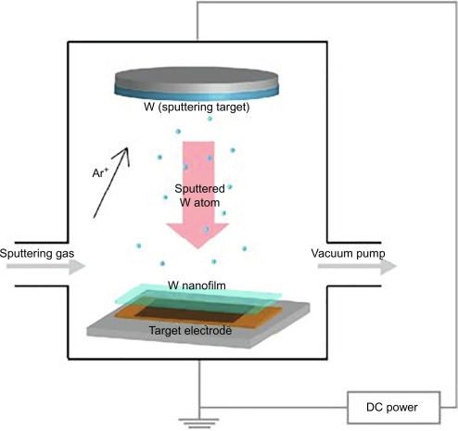
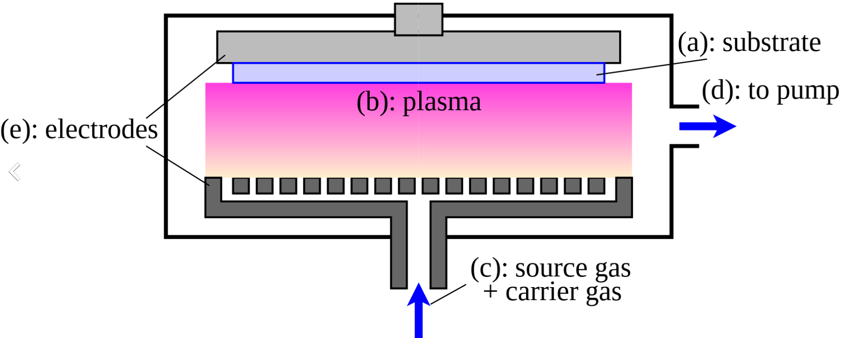
Thin film deposition
Thin film deposition: Thin film deposition refers to depositing a thin layer of material onto a substrate surface. These thin films are typically on the order of nanometers to micrometers in thickness.
There are several methods for thin film deposition, including:
Physical Vapor Deposition (PVD): Here, the material is vaporized from a solid source in a vacuum chamber and then condenses onto the patterned substrate, forming a thin film. Common PVD methods include evaporation and sputtering.
Chemical Vapor Deposition (CVD): In CVD, the desired material is deposited onto the patterned substrate surface through chemical reactions in the vapor phase. This can occur through processes such as thermal decomposition, pyrolysis, or plasma-enhanced chemical vapor deposition (PECVD).
Atomic Layer Deposition (ALD): ALD is a highly controlled deposition technique where thin films are built up layer-by-layer by sequentially exposing the substrate to alternating precursor gases, resulting in precise control over film thickness and composition.

Slide 10
Q) Isn’t stamping just another type of deposition ??
Ans: In a broad sense, Yes, stamping can be considered a type of deposition process. Technically, deposition refers to the process of depositing material onto a substrate, and stamping involves transferring material from one surface (e.g., a stamp) onto another surface (e.g., a substrate).
But generally, deposition often refers to processes like physical vapor deposition (PVD), chemical vapor deposition (CVD), atomic layer deposition (ALD), or other techniques where the material is deposited directly onto a substrate from a vapor or solution phase with the use of any intermediate. So, even though stamping technically does the same thing as deposition, it can’t be considered a type of deposition due to using an intermediate (stamp).
Q) As it was stated earlier, why specifically a ferromagnetic substance??
Ans: It is because of its unique properties like its memory, formation of FTJ (Ferroelectric Tunnel Junction) etc.

Slide 11
Ferro-electric materials
Ferro-electric materials: The type of materials that can change the direction of their electric polarization when an external electrical field is applied and retain the polarization even after the field is removed are known as Ferro-electric materials.
There are several other properties, including:
Spontaneous Polarization: As mentioned, Ferroelectric materials have a spontaneous electric polarization that exists even in the absence of an external electric field.
Reversibility/Versatility: Spontaneous polarization can be reversed by applying an external electric field i.e., the material can switch between two or more polarization states.
Hysteresis: Just Like in ferromagnetic materials, there is a lag between changes in the external electric field and changes in polarization for ferroelectric materials, too. This property is also known as Hysteresis.
Curie Temperature: The temperature above which the ferroelectric materials lose their ferroelectric properties and become paraelectric is known as the Curie temperature. Below the Curie temperature, the ferroelectric phase transition occurs.
Piezoelectricity: Ferroelectric materials also have the property to generate an electric field in response to mechanical stress or undergo mechanical deformation in response to an electric field.
Domain Structure: Ferroelectric materials have domain structures, where regions of uniform polarization (domains) are separated by domain walls. The application of an electric field can cause domain reorientation and domain growth.

Slide 12
FTJ (Ferroelectric Tunnel Junction)
The structure of an FTJ generally consists of a layer of ferroelectric material (InSe) sandwiched between two electrodes known as the top and bottom electrodes (Ti and Au respectively).
The ferroelectric layer between the electrodes has the property to exhibit spontaneous polarization that can be reversed by applying an external electrical field. This ability to switch between two stable polarization states is very crucial in FTJ.
Electron tunneling: Generally, tunneling refers to the quantum mechanical phenomenon where particles, such as electrons, can pass through a barrier that is generally impenetrable. In this case, as Au and Ti have different work functions, it is generally impossible for the electrons to pass through the barrier between them. In FTJs, the tunneling effect occurs due to the intrinsic properties of the thin ferroelectric layer sandwiched between metallic electrodes.
External Voltage Applied {Positive Polarization}: When an external voltage (field) is applied, it induces a positive polarization state in the ferroelectric material, lowering the potential barrier for electron tunneling. This leads to a higher tunneling current through the junction. In this case, the electric field should be from the high work function electrode to the low work function electrode.
External Voltage Applied {Negetive Polarization}: Similarly, applying an external voltage induces a negative polarization state in the ferroelectric material, increasing the potential barrier for electron tunneling. This results in a lower tunneling current through the junction. In this case, the electric field should be from the low work function electrode to the high work function electrode.
No External Voltage Applied: Without an external voltage, the ferroelectric material maintains its spontaneous polarization state. In this case, the tunneling current remains constant, dependent mainly by the intrinsic properties of the materials involved.

Slide 13
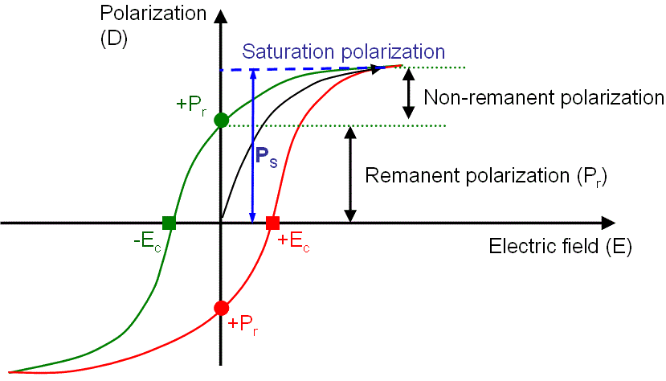
FTJ (Ferroelectric Tunnel Junction)
The polarization state of the ferroelectric layer can be read by measuring the tunneling current, and as it retains its state even when the power is turned off, it is very useful for data storage applications. Therefore, FTJs can be used as non-volatile memory devices.
Since the polarization state remains stable even without power, FTJs do not require continuous power supply to operate. Therefore, we can conclude that FTJs have low power consumption and are power efficient.
Let’s Take a deeper dive into Quantum electron tunneling.
polarization versus electric field hysteresis loop for a ferromagnetic material:
Source

Slide 14
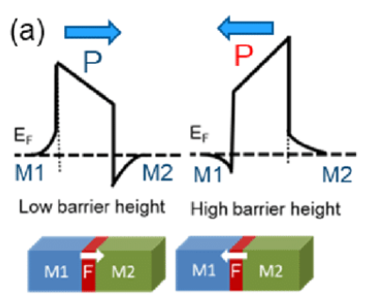
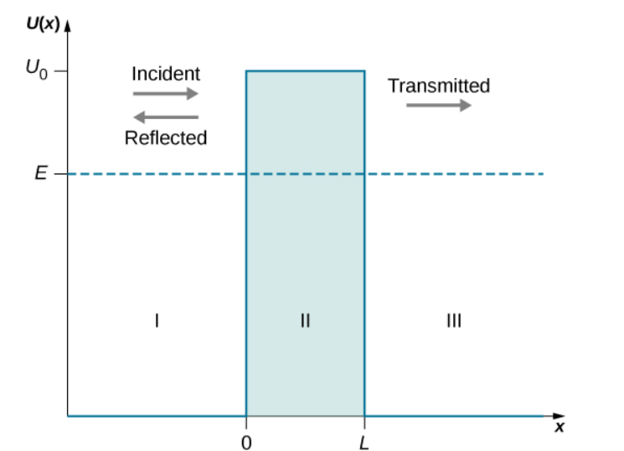
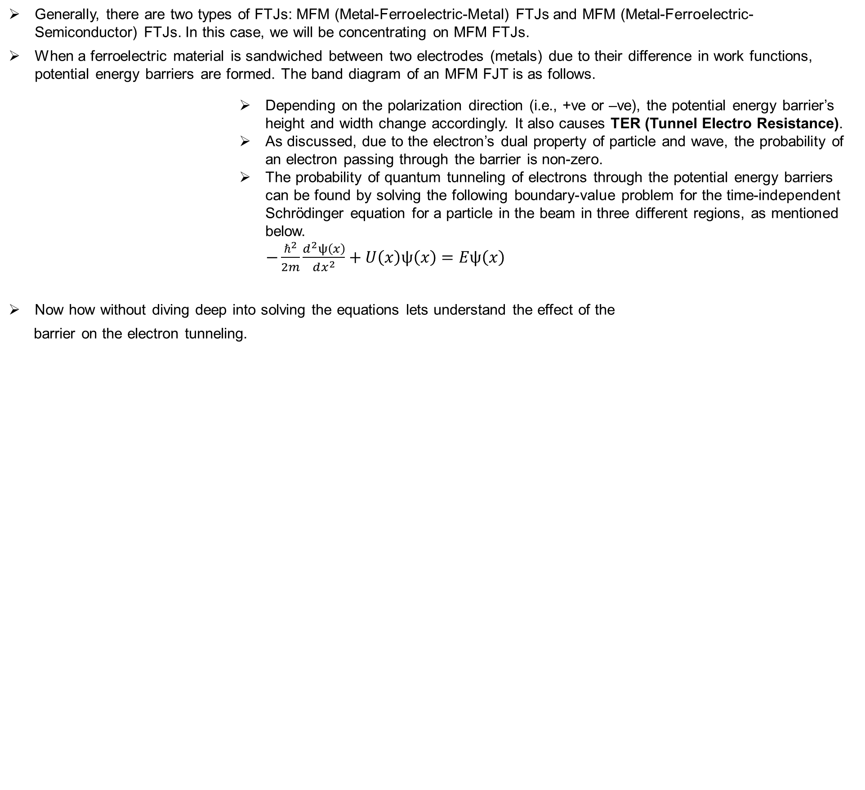
Quantum electron tunneling
Generally, there are two types of FTJs: MFM (Metal-Ferroelectric-Metal) FTJs and MFM (Metal-Ferroelectric-Semiconductor) FTJs. In this case, we will be concentrating on MFM FTJs.
When a ferroelectric material is sandwiched between two electrodes (metals) due to their difference in work functions, potential energy barriers are formed. The band diagram of an MFM FJT is as follows.
Depending on the polarization direction (i.e., +ve or –ve), the potential energy barrier’s height and width change accordingly. It also causes TER (Tunnel Electro Resistance).
As discussed, due to the electron’s dual property of particle and wave, the probability of an electron passing through the barrier is non-zero.
The probability of quantum tunneling of electrons through the potential energy barriers can be found by solving the following boundary-value problem for the time-independent Schrӧdinger equation for a particle in the beam in three different regions, as mentioned below.
$−\frac{ℏ^{2}}{2m}\frac{d^{2}ψ\left(x\right)}{dx^{2}}+U\left(x\right)ψ\left(x\right)=Eψ\left(x\right)$
Now how without diving deep into solving the equations lets understand the effect of the
barrier on the electron tunneling.
source

Slide 15
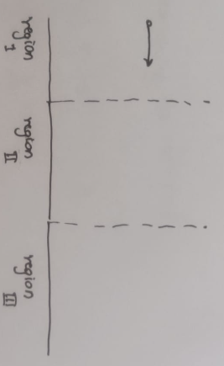
Quantum electron tunneling
In classical physics {particle property}, quantum tunneling doesn’t really make any sense. But in quantum physics {wave property}, the electron behaves as a wave and is represented by a wave function ψ(𝑥). The wave function exists throughout all of space. This means there's always a non-zero, however tiny, probability of finding the electron anywhere in the universe. Similarly, there is a probability that the electron can pass the barrier and exist on the other side of it.
Now, onto another point: how do the height and width of the barrier, affect the tunneling of the electrons?
Let us take a simple classical physics example to understand it.
Let us take a ball (in place of the electron) thrown from region 1 as shown, and in region 2 (barrier) alone, let the gravitational force (in place of the energy barrier) be directly proportional to the height of the potential barrier height.
Effect of width: Here, if the width is too large, the ball may or may not cross region 2. Even if we decrease the width by a small amount, it doesn’t make any difference, as the ball can still not cross it. To effectively change the width length, we have to decrease the size of the barrier until it becomes less than the distance the ball travelled horizontally.
Effect of height: Here, if the height of the barrier is even decreasing marginally, the vertical acceleration of the ball is increasing, making the rate at which the ball dies down a lot less. As we are dealing with acceleration, this is nearly twice as effective {more precisely squared} as the change in width. This is also true even in quantum mechanics, the tunneling current is very sensitive to the height of the barrier, and this has many physical applications, like Schottky contact gas sensors, etc.

Slide 16
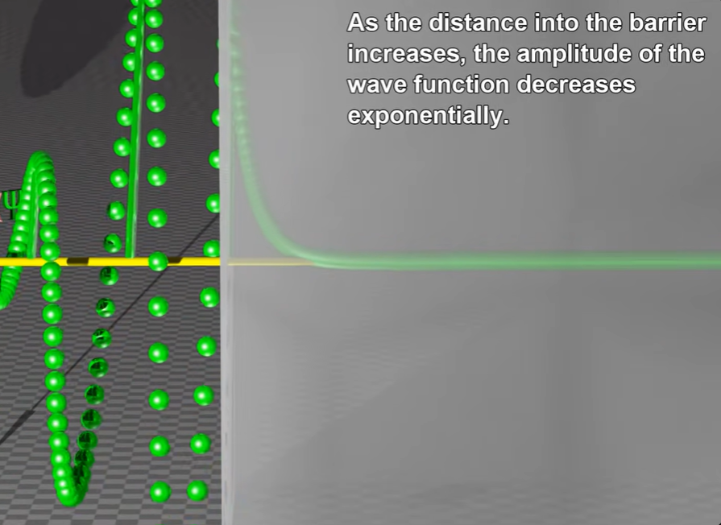
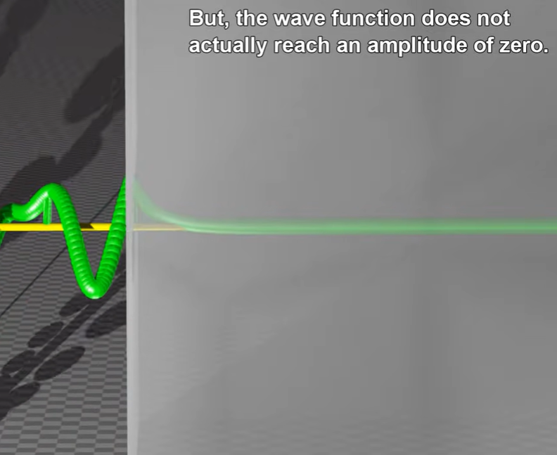
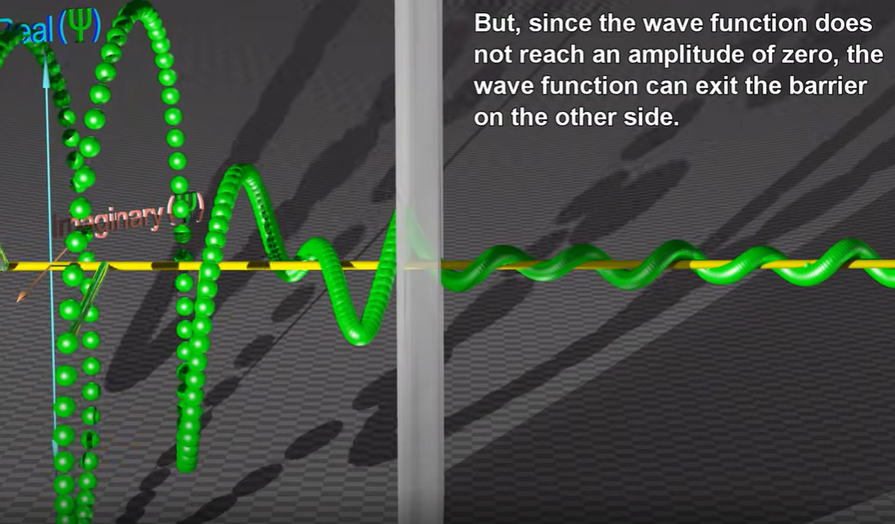
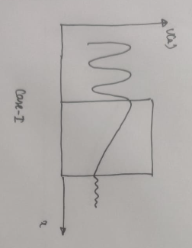
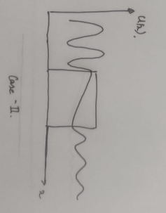
Quantum electron tunneling
As previously mentioned, in quantum mechanics, higher barriers lead to steeper drops in wave function magnitude, affecting tunneling probability in FTJs. Even slight changes in barrier height can impact current flow due to stronger opposing forces faced by particles. The change in the potential energy height of the barrier is generally considered the dominant factor.
Effect of barrier width on the electron tunnelling:
Case-1
Case-2
In case 1, the amplitude of the electron wave decreases rapidly, and the probability of crossing the barrier is low.
In case 2, due to low width the electron wave can pass through the barrier.
Source
Effect of barrier height on the electron tunnelling:
In case 1, the amplitude of the electron wave decreases rapidly, and the probability of crossing the barrier is low.
In case 2, due to low height the electron wave can pass through the barrier.

Slide 17
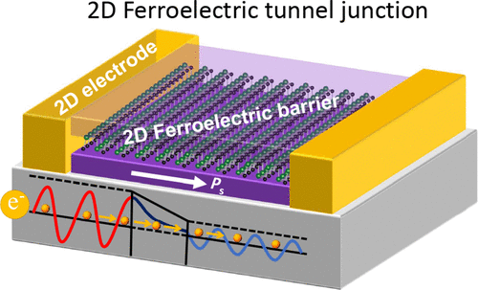
In-plane tunneling and Out-plane tunneling
The main difference between in-plane and out-of-plane tunneling lies in the direction of tunneling and the associated dimensional confinement. Here are the key distinctions between the two:
In-Plane Tunneling:
Direction: Charge carriers tunnel within a flat surface, parallel to the material layers.
Confinement: Movement is limited to the material's plane, encountering barriers perpendicular to this plane.
Applications: Used in devices where charge transport happens mainly within a flat plane, like tunnel junctions and graphene.
Out-of-Plane Tunneling:
Direction: Charge carriers tunnel through barriers perpendicular to the material layers.
Confinement: Carriers move between layers, with tunneling happening perpendicular to these layers.
Applications: Applied in structures where charge transport occurs between stacked layers, as seen in tunnel diodes and quantum well lasers.
This has been discussed in the previous slide and is related to quantum tunnelling
In-plane tunnelling:
Source

Slide 18
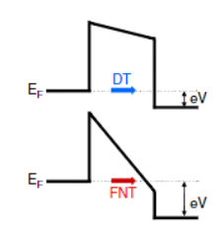
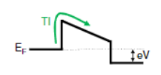
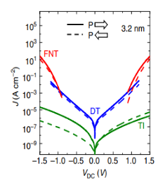
Transport mechanisms of electrons through barrier
Direct Tunnelling:
Direct tunneling occurs when electrons pass through a thin insulating layer, like a ferroelectric tunnel barrier, without needing intermediate energy states.
Electrons directly traverse from one electrode to another through the barrier, with tunneling probability exponentially tied to barrier thickness and height, as discussed earlier.
Fowler Nordheim Tunnelling:
Fowler-Nordheim tunneling happens when a potent electric field is applied to a thin insulating barrier.
Electrons tunnel through by surmounting the potential barrier via a mix of quantum tunneling and classical field emission.
Thermionic Emission:
Thermionic emission, also known as thermal electron emission or the Edison effect, is the phenomenon where electrons are liberated from a hot material due to the thermal energy they gain.
As the barrier thickness increases, direct tunneling current decreases exponentially, leading to thermionic emission dominating the current flow.
Source

Slide 19
Steps for Write and Read operations in FJT
Write operations:
Initial State: The FTJ starts in a specific spontaneous polarization state, signifying stored information.
Applying Write Voltage: A voltage pulse surpassing a threshold is applied to induce polarization switching.
Polarization Switching: The voltage pulse generates an electric field within the ferroelectric layer, potentially altering the polarization based on pulse magnitude and duration.
Final State: Once the voltage pulse is removed, the ferroelectric layer settles into a new polarization configuration, reflecting updated information or logic state until the next write operation.
Read operations:
Applying read voltage: Firstly, we must apply a gentle voltage across the FTJ. Note that the voltage should not be higher than the minimum field of the ferroelectric material so as not to induce a polarization switch.
Tunneling current measurement: Due to the applied voltage, a small electric field is generated across the ferroelectric layer, which further causes tunneling. We then measure the tunneling current, which is sensitive to the voltage applied. (as discussed before Effect of barrier on tunneling current)
Current Variation: The tunneling current varies depending on the polarization state of the ferroelectric layer. If the polarization state is in the +ve way, the tunneling current is higher, while in the –ve way, the tunneling current is lower. By measuring the tunneling current, the polarization state can be inferred, thus retrieving the stored information or logic state

Slide 20
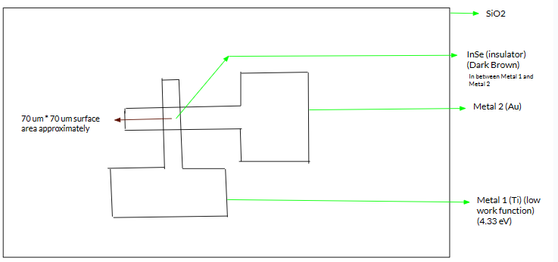
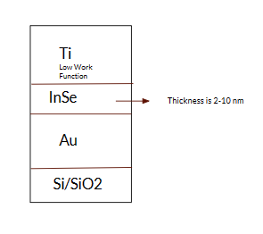
Steps for Dry transfer and Final Schematic
The final schematic should be as shown above.
We already have the InSe flakes deposited onto the lower metal from the Visco elastic transfer. Now we also need to include the top electrode by deposition methods, in our case dry transfer. The steps to follow are given below,
.
Pre-patterned Electrode Film: A thin film of the desired electrode material is first deposited and patterned on a separate substrate using techniques like photolithography and etching. This creates a pre-defined pattern of the electrode.
Dry Transfer Process: The pre-patterned electrode film is carefully placed onto the substrate containing the ferroelectric flakes.
Pressure and Heat: Applying controlled pressure and possibly low heat will cause the patterned electrode material to adhere to the substrate with the ferroelectric flakes, while the original substrate is separated.

